Slide 1
CSE 220
Data Structures
Lecture 06:
2D Arrays
Anwarul Bashir Shuaib [AWBS]
Lecturer
Department of Computer Science and Engineering
BRAC University

Slide 2

1D Arrays
int[] x = new int[5];
{0, 0, 0, 0, 0}
int[] x = {1, 2, 3, 4, 5};

Slide 3
1D Arrays
int[] x = new int[5];
{0, 0, 0, 0, 0}
Creating an array
int[] x = {1, 2, 3, 4, 5};

Slide 4
1D Arrays
whether each element is an integer
int[] x = new int[5];
{0, 0, 0, 0, 0}
Creating an array
int[] x = {1, 2, 3, 4, 5};

Slide 5

1D Arrays
x = np.zeros(5, dtype=int)
{0, 0, 0, 0, 0}
x = np.array([1, 2, 3, 4, 5], dtype=np.int32)

Slide 6
1D Arrays
Elements are stored consecutively in memory
Memory Address | Elements
0x100 | x[0]
0x104 | x[1]
0x108 | x[2]
0x10C | x[3]
… | …

Slide 7
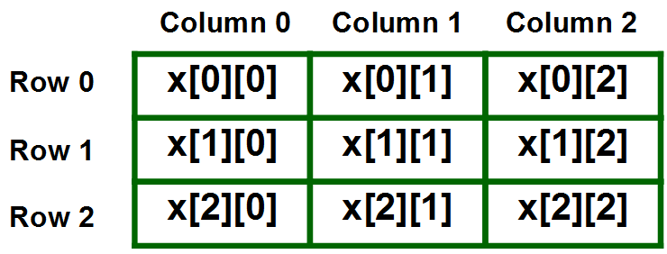
2D Arrays
int[][] x = new int[3][3];
x = np.zeros((3,3), dtype=np.int32)

Slide 8
2D Arrays
int[][] x = new int[3][3];
Creating an array
x = np.zeros((3,3), dtype=np.int32)

Slide 9
2D Arrays
Where each element is an integer array
int[][] x = new int[3][3];
Creating an array
x = np.zeros((3,3), dtype=np.int32)

Slide 10
2D Arrays
int[][] x = {
{1, 2, 3},
{4, 5, 6},
{7, 8, 9}
}
1 | 2 | 3
4 | 5 | 6
7 | 8 | 9
x = np.array(
[
[1, 2, 3],
[4, 5, 6],
[7, 8, 9]
], dtype=np.int32)

Slide 11
2D Arrays
x.length = # rows in the array
int[][] x = {
{1, 2, 3},
{4, 5, 6},
{7, 8, 9}
}
1 | 2 | 3
4 | 5 | 6
7 | 8 | 9
x = np.array(
[
[1, 2, 3],
[4, 5, 6],
[7, 8, 9]
], dtype=np.int32)

Slide 12
2D Arrays
x[0].length = # columns in the array
int[][] x = {
{1, 2, 3},
{4, 5, 6},
{7, 8, 9}
}
1 | 2 | 3
4 | 5 | 6
7 | 8 | 9
x = np.array(
[
[1, 2, 3],
[4, 5, 6],
[7, 8, 9]
], dtype=np.int32)

Slide 13
2D Arrays
Elements are still stored consecutively.
Consider: int[][] arr = new int[2][3];
Memory Address | Element
0 | arr[0][0]
1 | arr[0][1]
2 | arr[0][2]
3 | arr[1][0]
4 | arr[1][1]
5 | arr[1][2]
arr[0][0] | arr[0][1] | arr[0][2]
arr[1][0] | arr[1][1] | arr[1][2]

Slide 14
2D Arrays
Elements are still stored consecutively.
Consider: int[][] arr = new int[2][3];
row = 2, col = 3
Memory Address | Element
0 | arr[0][0]
1 | arr[0][1]
2 | arr[0][2]
3 | arr[1][0]
4 | arr[1][1]
5 | arr[1][2]
arr[0][0] | arr[0][1] | arr[0][2]
arr[1][0] | arr[1][1] | arr[1][2]

Slide 15
2D Arrays
Elements are still stored consecutively.
Consider: int[][] arr = new int[2][3];
row = 2, col = 3
Memory Address | Element
0 | arr[0][0]
1 | arr[0][1]
2 | arr[0][2]
3 | arr[1][0]
4 | arr[1][1]
5 | arr[1][2]
arr[0][0] | arr[0][1] | arr[0][2]
arr[1][0] | arr[1][1] | arr[1][2]
arr[0][2] ⇒ 0 * col + 2 = 2

Slide 16
2D Arrays
What about finding row, column from linear index?
Memory Address | Element
0 | arr[0][0]
1 | arr[0][1]
2 | arr[0][2]
3 | arr[1][0]
4 | arr[1][1]
5 | arr[1][2]
Given linear index 5, find rowIndex and columnIndex.

Slide 17
2D Arrays
What about finding row, column from linear index?
Memory Address | Element
0 | arr[0][0]
1 | arr[0][1]
2 | arr[0][2]
3 | arr[1][0]
4 | arr[1][1]
5 | arr[1][2]
Given linear index 5, find row and col.
Total columns in the original array
row = 5 / 3 = 1
col = 5 % 3 = 2

Slide 18
Summary
int[][] arr = new int[row][col];
  arr[i][j] located at address i*col + j
  Given index N: i = N / col, j = N % col
int[][][] arr = new int[P][Q][R];
  arr[i][j][k] located at address i*(Q*R) + j*R + k
  Also possible to calculate i,j,k from given index N (next slide)
Linear indices can always map N-dimensional arrays to 1D arrays.

Slide 19
Summary
N%(Q*R)
N = i*(Q*R) + j*R + k
i = N/(Q*R)
j = (N%(Q*R))/R
k = (N%(Q*R))%R
No need to memorize. Try to understand how the calculations work here.

Slide 20
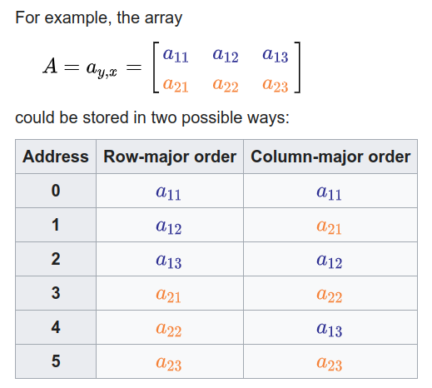
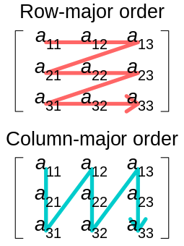
Ordering
Column-major order is rarely (almost never) used nowadays.

Slide 21
Exercises
Create and Print a 2D Array
  Declare an m x n integer array.
  Fill it with values and print it row by row.
Find Maximum and Minimum Elements
Compute the sum of all elements in a 2D array.
Row-wise and Column-wise Sum
Transpose of a Matrix
  Swap arr[i][j] with arr[j][i] for a square matrix.

Slide 22
More Exercises
Check if a given number exists in the 2D array and return its position (both linear index and row, col)
Diagonal Sum (For Square Matrices)
  Compute the sum of the main diagonal (arr[i][i]) and secondary diagonal (arr[i][n-i-1]).
Rotate 90 Degrees (Clockwise/Counterclockwise)
  Clockwise ⇒ transpose, then reverse rows.
Check Symmetry (Palindrome Matrix)
  Verify if a matrix is symmetric (arr[i][j] == arr[j][i]).

Slide 23

Even More Exercises!
Matrix multiplication
Determinant of an square matrix (try if you have time)
  2x2, 3x3 is easy. For nxn, you will need recursion

Slide 24
